Slide 1
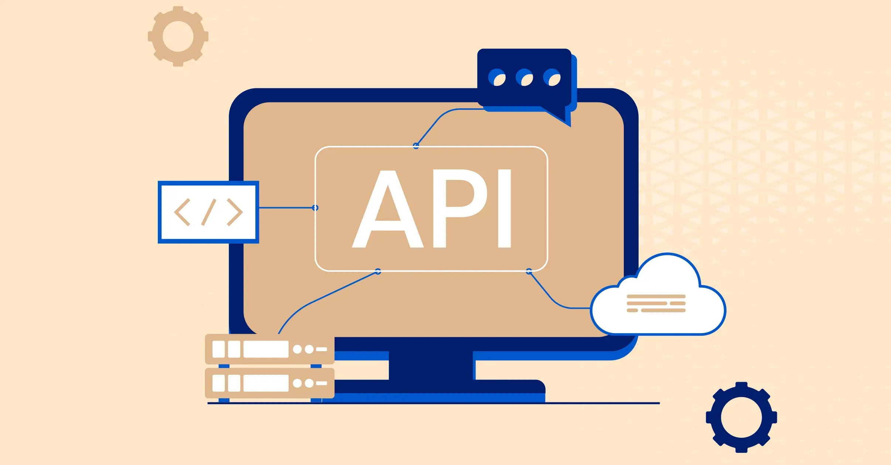
API
Application Programming Interface

Slide 2

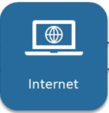
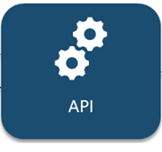
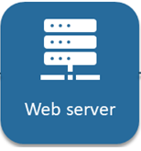
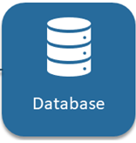
How API works
Request
Response

Slide 3
What is API?
Collection of
communication protocols and subroutines
used by various programs
to communicate between them

Slide 4
Intro to APIs
Definition: APIs (Application Programming Interfaces) are sets of protocols, routines, and tools that allow different software applications to communicate and interact with each other.
Explanation: They define the methods and data formats that applications can use to request and exchange information, enabling seamless integration and functionality.
Examples: Weather APIs for fetching real-time weather data, Payment APIs for processing online transactions, Social Media APIs for accessing user profiles and content.

Slide 5
Importance of APIs
Role in Software Development: APIs play a crucial role in modern software development by enabling developers to access functionalities and data from other applications or services.
Benefits: Faster development, increased functionality, scalability, interoperability, and integration with third-party services.
Case Studies: Examples of companies leveraging APIs for innovation and business growth (e.g., Google Maps API, Stripe API).
Case Studies: Examples of companies leveraging APIs for innovation and business growth (e.g., Google Maps API, Stripe API).

Slide 6
Types of APIs
RESTful APIs: Based on REST (Representational State Transfer) architecture, using standard HTTP methods (GET, POST, PUT, DELETE) for communication.
SOAP APIs: Using XML-based messaging protocol for communication, often used in enterprise systems.
GraphQL APIs: Query language for APIs, providing more flexibility and efficiency in data retrieval.
Other APIs: Mentioning RPC (Remote Procedure Call), WebSockets, gRPC (Google Remote Procedure Call), etc., for broader context.

Slide 7
API Components
Endpoints: URLs that clients use to interact with the API (e.g., https://api.example.com/users).
Methods: HTTP methods such as GET (retrieve data), POST (create data), PUT (update data), DELETE (delete data).
Parameters: Data passed in API requests (query parameters, request body, headers) to customize the request
Responses: Data returned by APIs in response to client requests (JSON, XML, HTML, etc.).

Slide 8
API Documentation
Importance: Clear and comprehensive API documentation is essential for developers and API consumers to understand how to use the API effectively.
Tools: Swagger, OpenAPI Specification, RAML are popular tools for documenting APIs, providing structured and interactive documentation.
Examples: Showcase examples of well-documented APIs and highlight the impact on usability and adoption.

Slide 9
API Standards and Best Practices
Consistency: Maintain consistency in API design, naming conventions, and response formats to enhance usability and developer experience.
Versioning: Implement versioning strategies to manage changes and ensure backward compatibility.
Security Practices: Secure APIs with authentication, authorization, encryption, and validation mechanisms to protect sensitive data and prevent unauthorized access.
Error Handling: Implement robust error handling and status codes to provide meaningful responses and troubleshoot issues effectively.

Slide 10
APIs in Action
Real-world Examples: Showcase how APIs power popular applications and services, such as social media platforms, e-commerce websites, and financial services.
Integration: Demonstrate how APIs enable integration between different platforms, systems, and devices, fostering innovation and collaboration.
Use Cases: Highlight specific API use cases across various industries (finance, healthcare, education, etc.), showcasing the versatility and impact of APIs.

Slide 11
Challenges and Considerations
Common Challenges: Address common challenges in API development and integration, such as security vulnerabilities, scalability issues, versioning conflicts, and performance optimization.
Considerations: Discuss factors to consider when choosing the right API architecture, protocol, and design patterns based on project requirements, scalability needs, and future growth.
Strategies: Provide strategies and best practices for overcoming API-related challenges and ensuring long-term success, such as API governance, testing methodologies, and monitoring solutions.

Slide 12
Future Trends in APIs
Emerging Technologies: Explore emerging technologies shaping the future of APIs, such as microservices architecture, serverless computing, AI/ML APIs, and IoT integration.
Trends: Discuss trends in API design and development, including hypermedia APIs, event-driven APIs, API monetization strategies, and API marketplaces.
Opportunities and Challenges: Identify opportunities and challenges in adopting new API technologies and standards, and how organizations can leverage APIs for innovation, growth, and competitive advantage.

